Slide 1
Coursera: ibm Applied data science
capstone project
Open a new restaurant in Manhattan
By: biying(karen) Deng
Sept,2019

Slide 2
Presentation consists the following components:
Introduction
Description of Data
Methodology
Result
Discussion
Conclusion
Reference

Slide 3
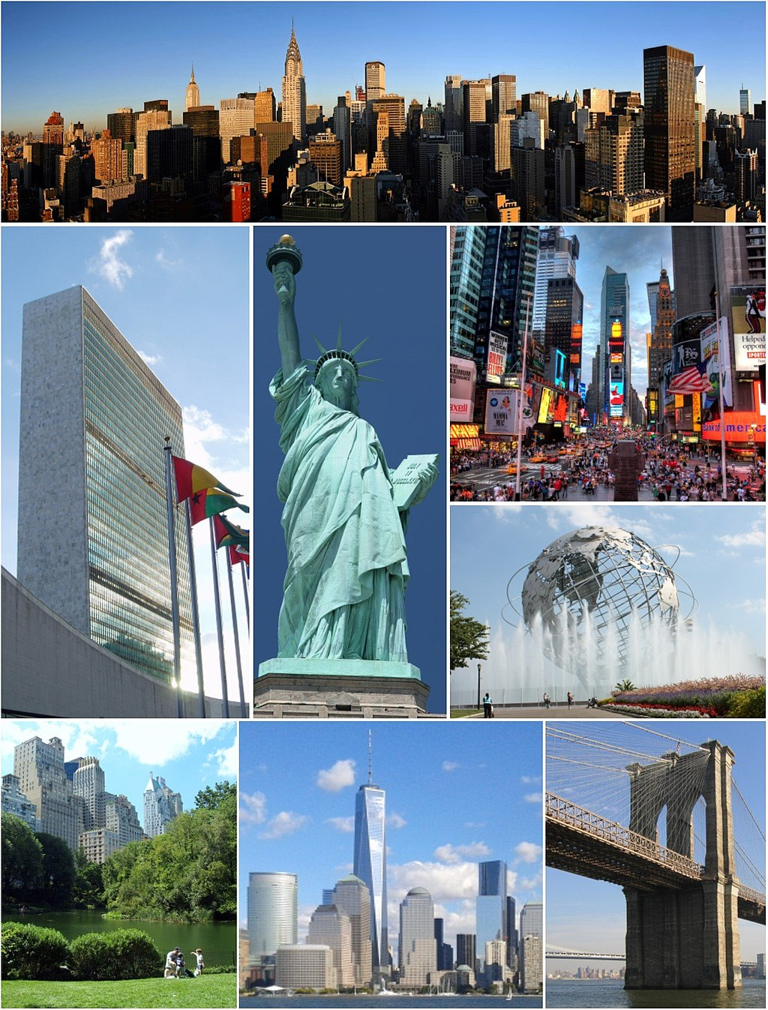
Introduction
Business Problem:
Location for restaurant is one of the most important key factors in real world, which directly affect sustainability and success in the future. In order to help our investor in deciding a better location to open a new restaurant, we will utilize different type of data.
About background city
New York City is the most popular and the most densely populated major city in the United States.
It has a great impact in multiple field such as entertainment, fashion, financial, media, tourism and especially famous for its commerce.
Manhattan, which is the most representative and well-known boroughs in New York City. We will focus on this borough for this project.
https://en.wikipedia.org/wiki/New_York_City#/media/File:NYC_Montage_2014_4_-_Jleon.jpg

Slide 4
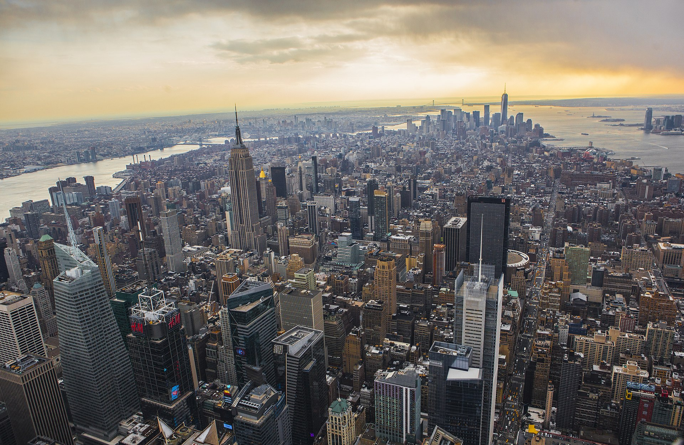
Introduction
For this project, our problem will target on Manhattan’s neighborhood to explore what are the difference among these neighborhoods. Considering that if we want to pick target neighborhoods for new restaurant, what are possible factors that we need to consider. This project can provide a quick exploration of 40 major neighborhoods in Manhattan by considering different statistics of each neighborhoods.
Target audience: Investors from all around the world, who want to pick a neighborhood and open a new restaurant in Manhattan.
https://en.wikipedia.org/wiki/Manhattan#/media/File:Above_Gotham.jpg

Slide 5
Description of data
1. New York Neighborhood data that provide previously in Coursera course, and we narrow down to neighborhoods within Manhattan, which includes 40 major neighborhoods.
Source:https://geo.nyu.edu/catalog/nyu_2451_34572
2. Obtaining restaurants information, type, location in neighborhood using Foursquare API
Other Demographic data from websites:
1. 'zipcode' data was from Wikipedia that I search one by one according to the Neighborhood. Use to locate each specific neighborhood and helps in grabs other demographic data online.
2. Income data was searched one by one from website 'https://www.incomebyzipcode.com/' by passing the zipcode from above. It consists Per-capita income, median household and average household income.
3. Part of the Population data are from below, and part of them are searched from Wikipedia. It will show approximately how many residents will be in each neighborhood.
https://www.worldatlas.com/articles/manhattan-neighborhoods-by-population.html

Slide 6
Methodology
Scraping demographic data from Wikipedia page and other open data websites including NYC official websites.
Plotting histogram of all income statistics (Median household income, Average household income, Per-capita income) we have in data and see what’s the difference for each neighborhood, which are the top 5 neighborhoods.
Using Foursquare API to scrape venues for each neighborhood.
Creating interactive crime maps with folium by using crime complaint data in NYC OpenData Websites.
Creating interactive neighborhood maps within Manhattan.
Top 10 most common venue type in each neighborhood.
Applying k-means clustering method to cluster venue types.

Slide 7
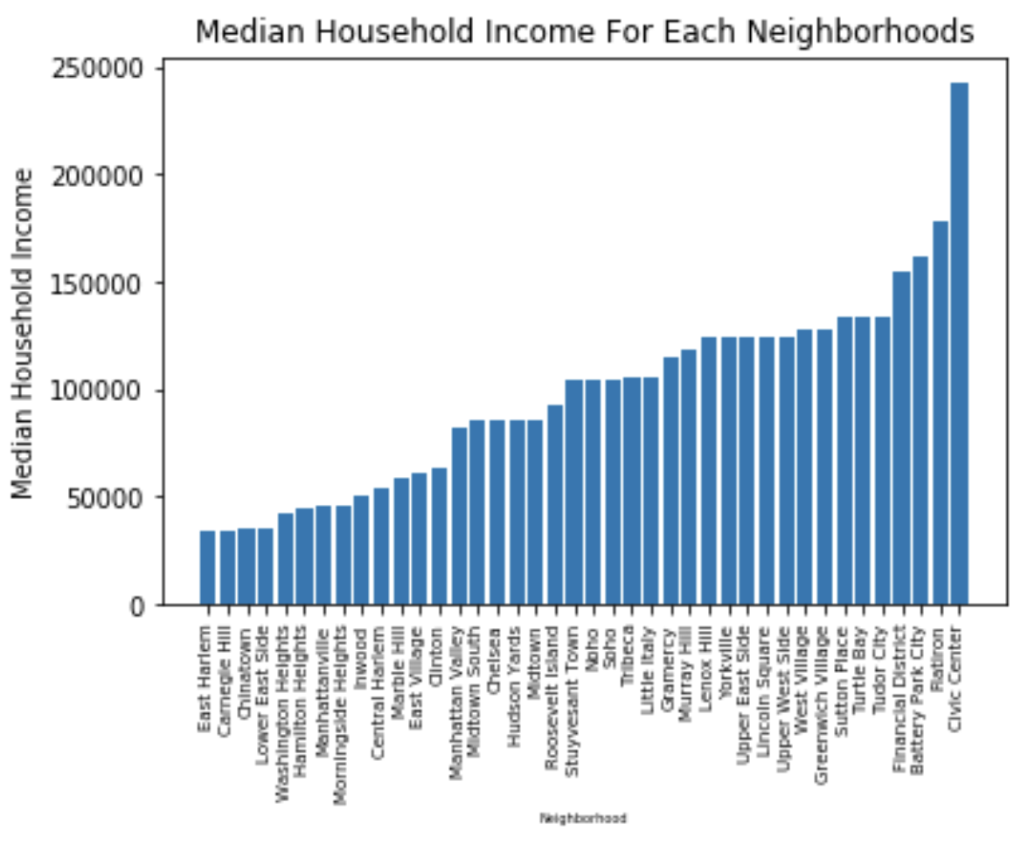
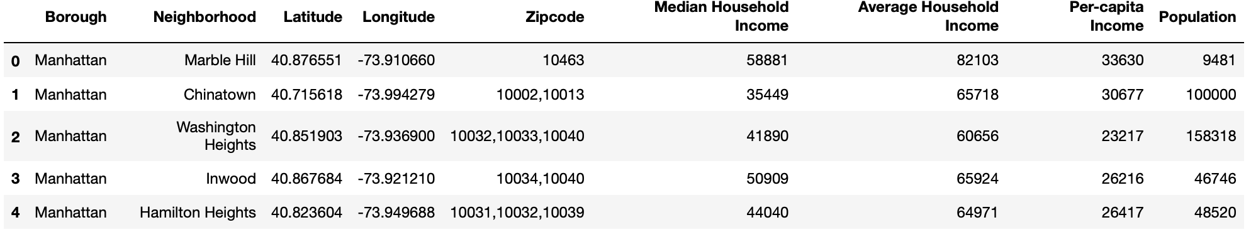
Result
It is possible that people with higher income may have more money or more likely to try a new restaurant. With higher surrounding household income, it will be better for business sustainability of this restaurant as well.
Screenshot of combined data is on right bottom, which shows each neighborhoods’ income statistics, location, population and neighborhoods location information.
From the top right plot, it shows how each neighborhoods’ median household income different from each other. Top five neighborhoods are Turtle Bay, Tudor City, Financial District, Battery Park City, Radio Row and Civic Center.

Slide 8
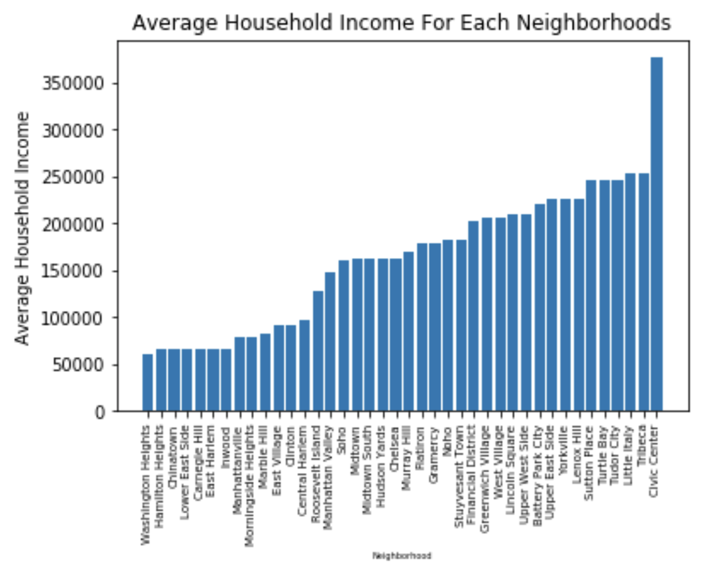
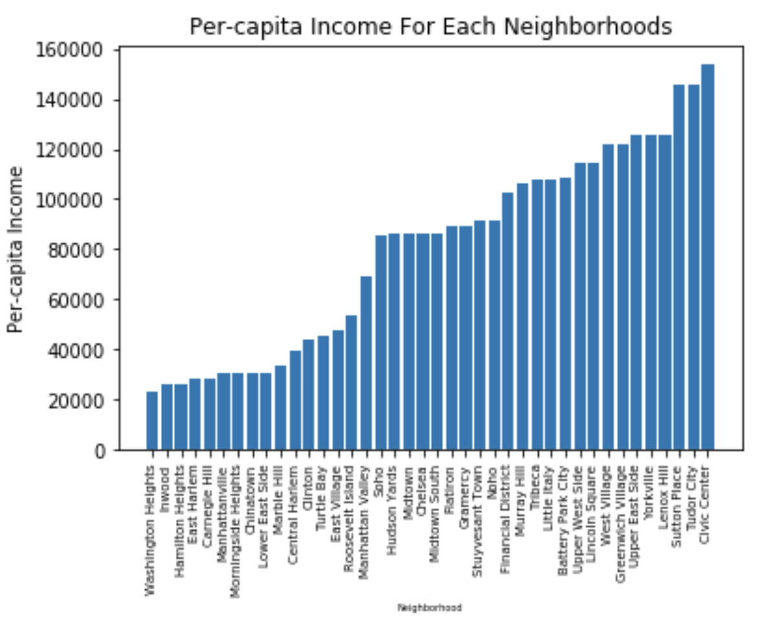
Demographic data visualization
For the top right plot, it shows the average household income for each neighborhoods in Manhattan. The top 5 neighborhood with highest average household income are Turtle Bay, Tudor City, Little Italy, Tribeca and Civic Center.
For the bottom right plot, it shows the per-capita income for each neighborhoods. Top 5 neighborhoods with highest per-capita income are Yorkville, Lenox Hill, Sutton Place, Tudor City, and Civic Center.

Slide 9
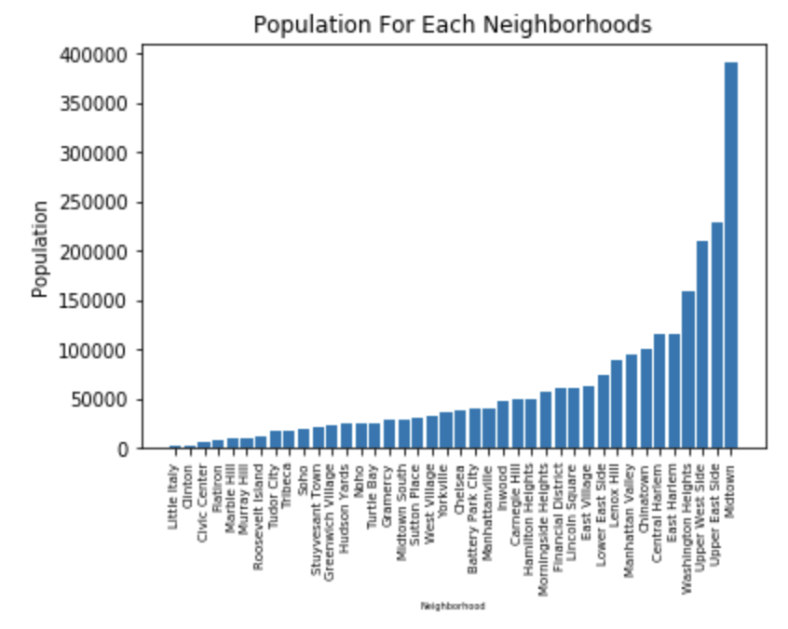
Population
Anther factor that may affect local business of restaurant will be the local population density in each neighborhood. More residents around may bring more new customers for this restaurant.
From plot on the right, top 5 neighborhoods with the most population are East Harlem (Same as Central Harlem) , Washington Heights, Upper West Side, Upper East Side and Midtown.

Slide 10
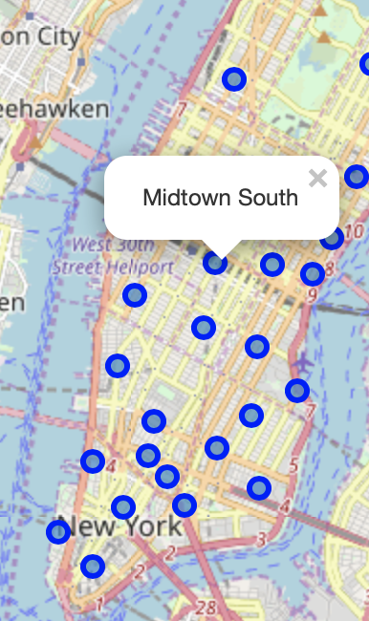
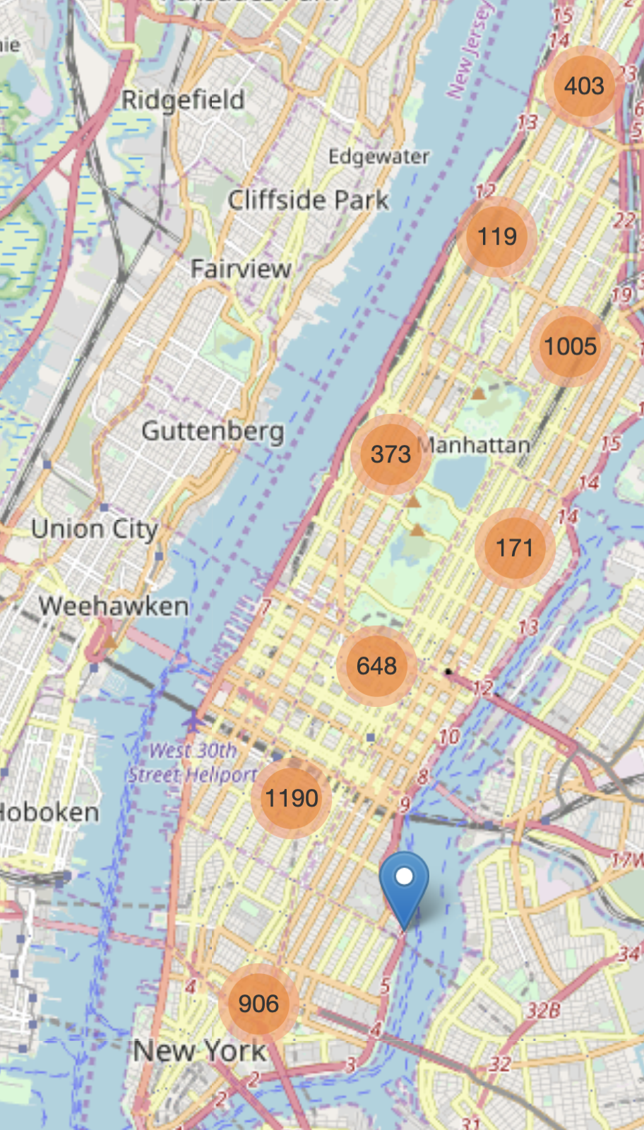
Crime map
By creating this interactive crime map (Right) and neighborhoods map(Left), we can see how many crime(felony, misdemeanor, violation) in specific area reported to NYPD so far till this year 2019.
Result: Midtown, Midtown South and Central Harlem area tend to have more crime complaints by looking at both map, while Upper West side, Lincoln Square and Yorkville area have less crime complaints.

Slide 11
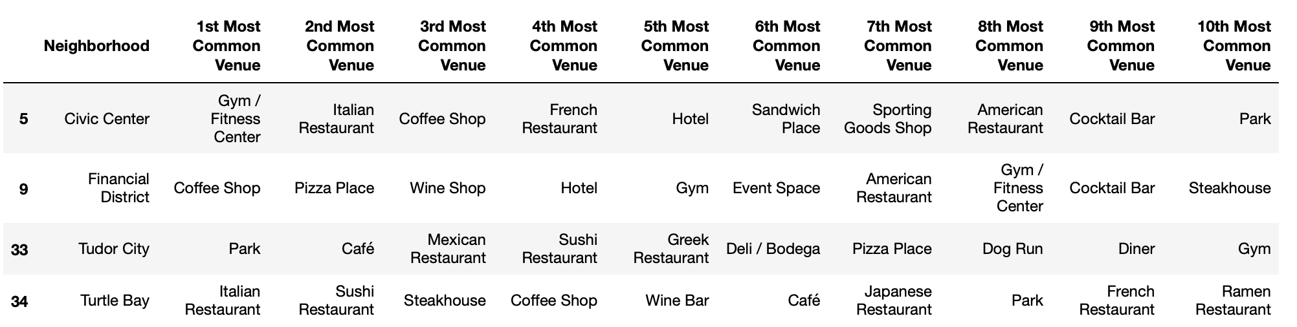
Top 10 most common venue for higher income neighborhoods
From the above, it shows top 10 most common venues in each neighborhood. If we looks at those common neighborhood with higher household income such as Civic Center, Turtle Bay, Financial District and Tudor City. The common venue they have in common are Italian Restaurant, Café, Coffee Shop, Steakhouse, Wine Bar, etc.

Slide 12
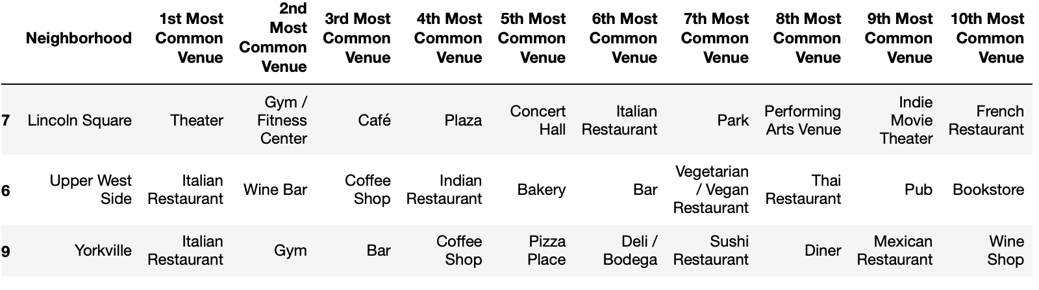
Top 10 most common venue for less crimes neighborhood
From the above it shows top 10 most common venues within these neighborhood with less crime reported or more safe for people to eat around are Upper West side, Lincoln Square and Yorkville area . The common venue they have in common are Italian Restaurant and Coffee Shop.

Slide 13
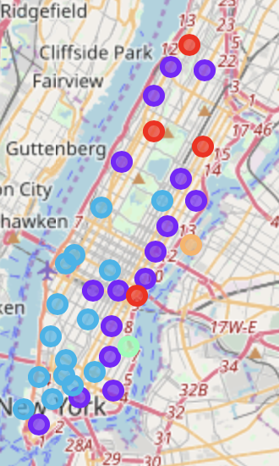
K-mean clustering neighborhoods
Majority neighborhoods were clustered into Cluster 1 (Purple), Cluster 2 (Blue) and Cluster 3(Red), with only 1 neighborhood in each cluster 4 and 5.
Cluster1: neighborhoods in cluster 1 majority venue are Café, Mexican Restaurant, Pizza Place, Indian Restaurant and Deli / Bodega.
Cluster 2:neighborhoods are characterized by venue such as Coffee Shop, Bar, Wine Bar, Gym/Fitness Center.
Cluster 3: Majority venues in these neighborhoods are Italian Restaurant, Clothing Store, Gym / Fitness Center, Coffee Shop/Café.

Slide 14
discussion
Observation:
1.Neighborhoods characteristics (less crime, higher population density, higher household income) can be associate with surrounding restaurant concept.
2.Base on observation, neighborhoods with higher household income and less crime complaints tend to have more Italian restaurant and Coffee shop. Investors could make use of this information when deciding their restaurant concept or restaurant location.
3.Midtown (Time Square) and Midtown South (Korean town and Penn Station) are the most representative popular place that includes a lot of different type of restaurants. They are both favorite place for visitors and local residents to shop around, even though they may high in crime complaints according to our crime map.
Recommendation for future investigation:
We could use Elbow Method to find the optimal K to optimize our clustering results.
Include demographic data when do our clustering.
Include more data (transportation, rent space price, etc.)
Build a basic recommendation system to help investors in decision-making.

Slide 15
conclusion
This report can provide a general direction in helping investors to make decision on where to open their new restaurant, or what kind of restaurant concept they can pick if it is opened in specific neighborhoods base on our clustering results . However, it is a broad topic that we can investigate deeper in different way. Results in this report may not be perfect and may need further improvement in general.

Slide 16
Reference
New York Neighborhood data: https://geo.nyu.edu/catalog/nyu_2451_34572
Income data : https://www.incomebyzipcode.com/
Part of Population data: https://www.worldatlas.com/articles/manhattan-neighborhoods-by-population.html
Picture in sides 3 : https://en.wikipedia.org/wiki/New_York_City#/media/File:NYC_Montage_2014_4_-_Jleon.jpg
Picture in sides 4:
https://en.wikipedia.org/wiki/Manhattan#/media/File:Above_Gotham.jpg

Slide 17
Thank you for watching

